Slide 1
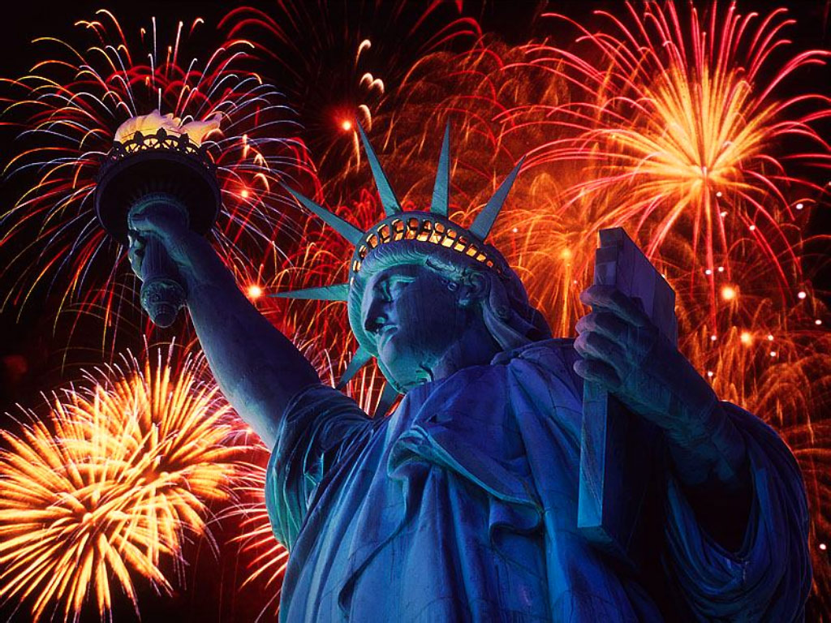
God bless America

Slide 2
God reigns over the nations;
God is seated on his holy throne.
Psalms 47:8

Slide 3
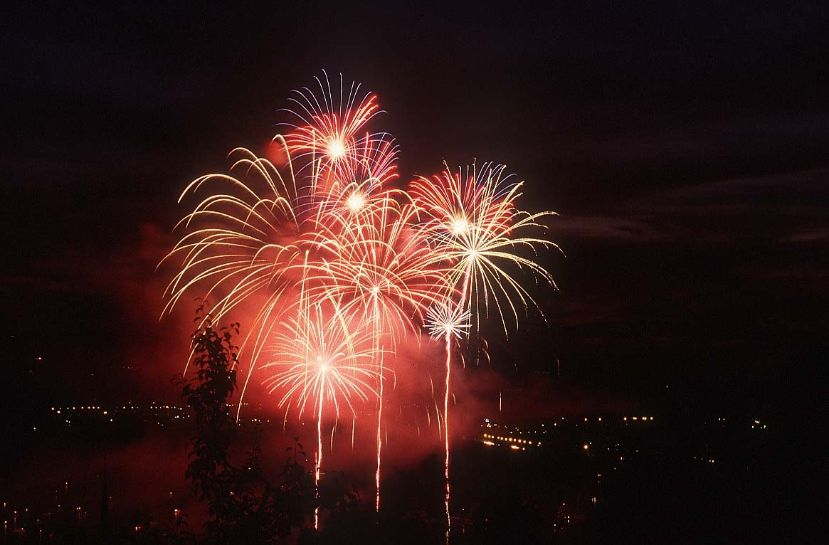
1 Chronicles 16:8
Give praise to the LORD, proclaim his name; make known among the nations what he has done.

Slide 4
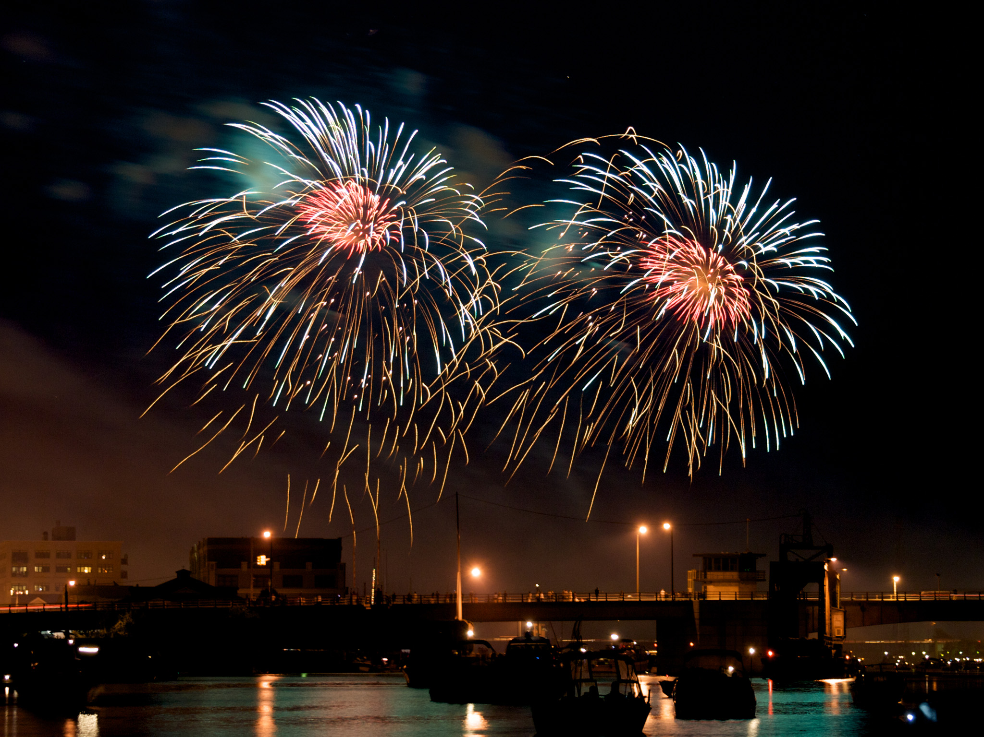
1 Chronicles 16:31 Let the heavens rejoice, let the earth be glad; let them say among the nations, “The LORD reigns!”

Slide 5
Job 12:22-23
God reveals the deep things of darkness and brings utter darkness into the light. He makes nations great, and destroys them; He enlarges nations, and disperses them.

Slide 6
2 Chronicles 7: 14 if my people, who are called by my name, will humble themselves and pray and seek my face and turn from their wicked ways, then I will hear from
heaven, and I will forgive their sin and will heal their land.

Slide 7
Exodus 19:5 Now if you obey me fully and keep my covenant, then out of all nations you will be my treasured possession.

Slide 8
Psalms 46: 10 Be still, and know that I am God; I will be exalted among the nations, I will be exalted in the earth.

Slide 9
Righteousness exalts a nation, but sin condemns any people.
Proverbs 14: 34

Slide 10
2 Chronicles 20:6 LORD, the God of our ancestors, are you not the God who is in heaven? You rule over all the kingdoms of the nations. Power and might are in your hand, and no one can withstand you.

Slide 11
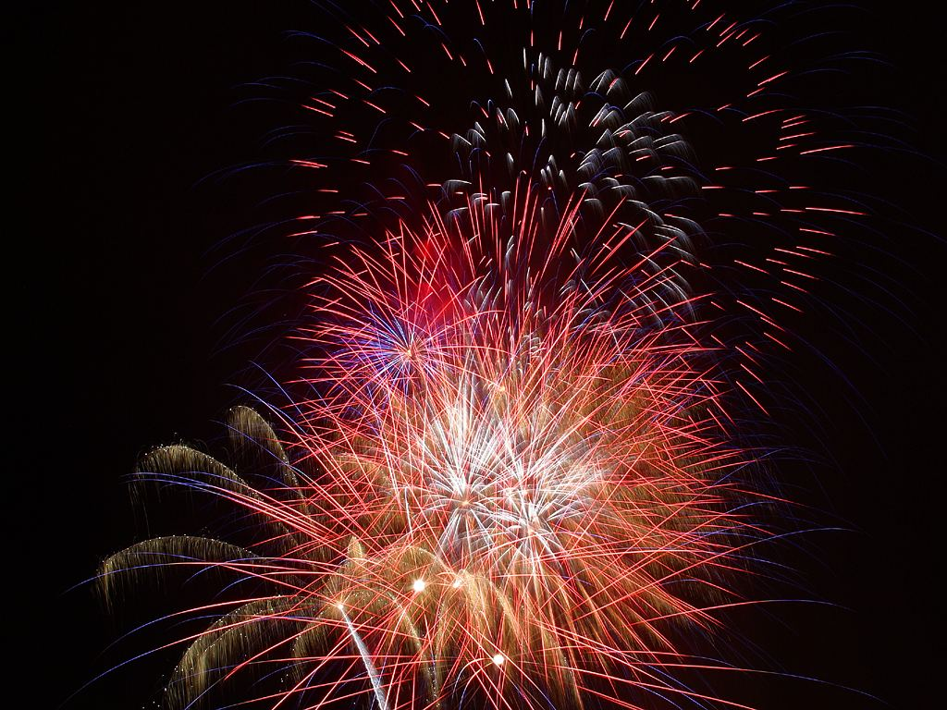
Psalms 86:9
All the nations you have made will come and worship before you, Lord; they will bring glory to your name.

Slide 12
Psalms 22: 27-28
All the ends of the earth will remember and turn to the LORD, and all the families of the nations will bow down before him, for dominion belongs to the LORD and he rules over the nations.

Slide 13
Psalms 113: 4
The LORD is exalted over all the nations, his glory above the heavens.

