Slide 1
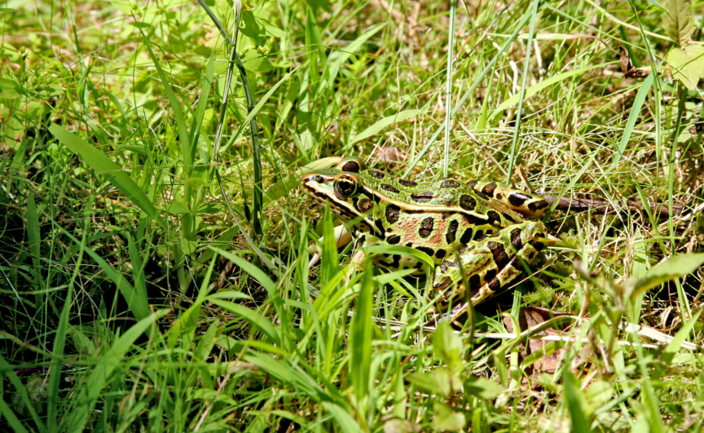

Slide 2
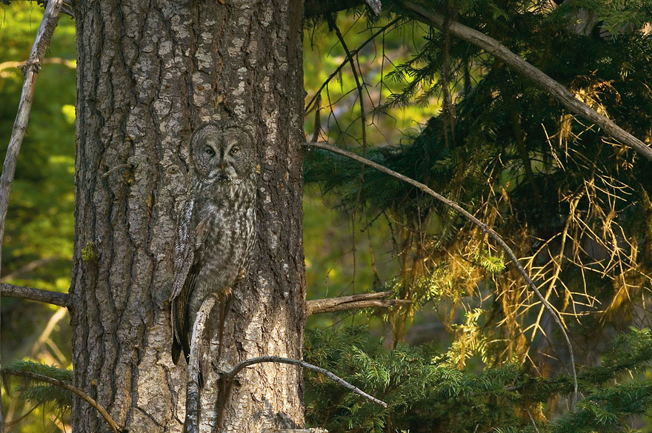

Slide 3
The desert owl and screech owl will possess it; the great owl and the raven will nest there. Isaiah 34:11

Slide 4
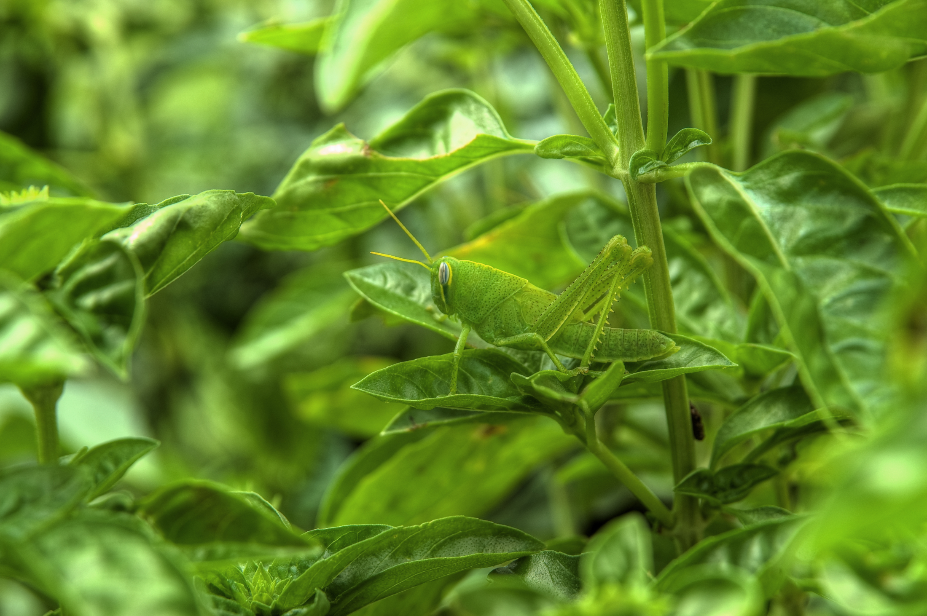

Slide 5
God sits enthroned above the circle of the earth, and its people are like grasshoppers. Isaiah 40:22

Slide 6
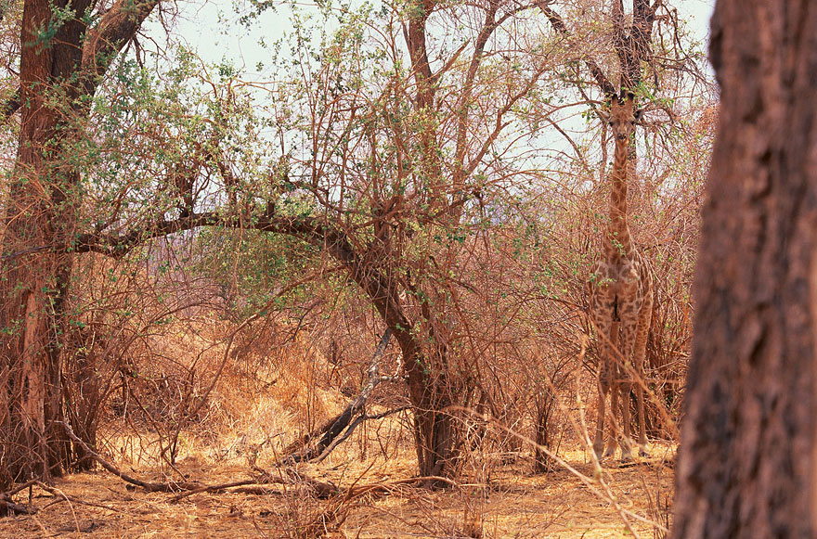

Slide 8
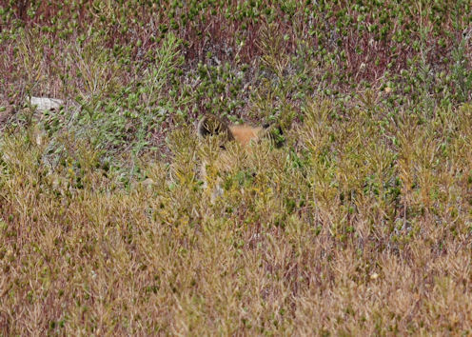

Slide 9
Jesus replied, “Foxes have dens and birds have nests, but the Son of Man has no place to lay his head.” Matthew 8:20

Slide 10
The high mountains belong to the wild goats; the crags are a refuge for the hyrax.
Psalm 104:18

Slide 11
Hyraxes are creatures of little power, yet they make their home in the crags.
Proverbs 30:26

Slide 12
For we live by faith,
not by sight.
2 Corinthians 5:7

Slide 13
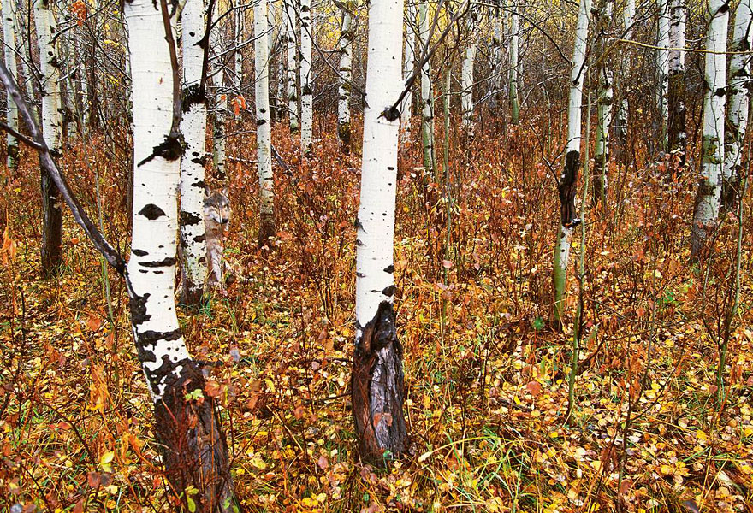

Slide 14
Therefore a lion from the forest will attack them, a wolf from the desert will ravage them. Jeremiah 5:6

Slide 15
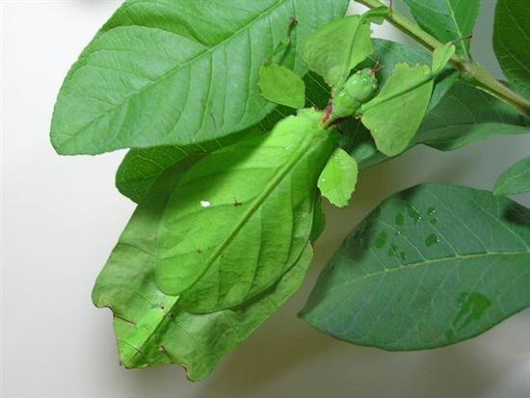

Slide 18
The wild animals honor me, the jackals and the owls, because I provide water in the wilderness and streams in the wasteland.
Isaiah 43:20

Slide 19
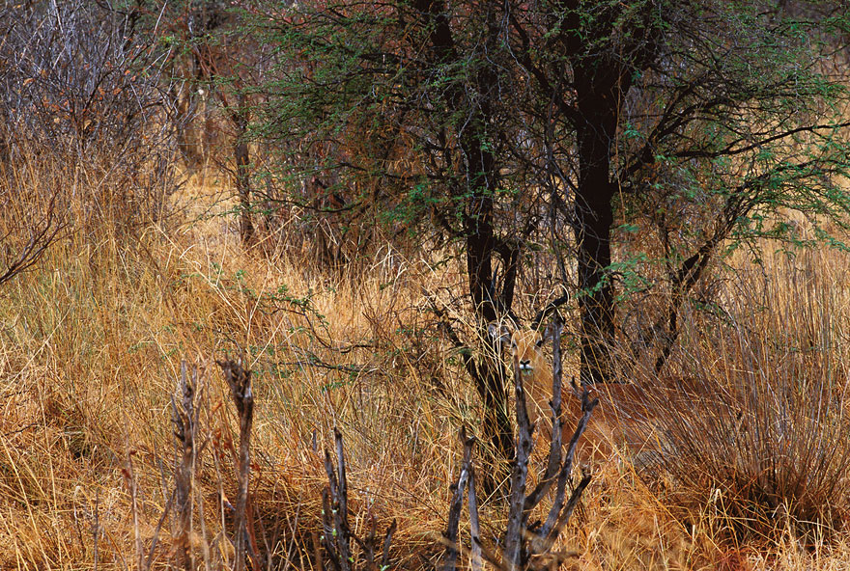

Slide 20
As the deer pants for streams of water, so my soul pants for you, my God. Psalm 42:1

Slide 21
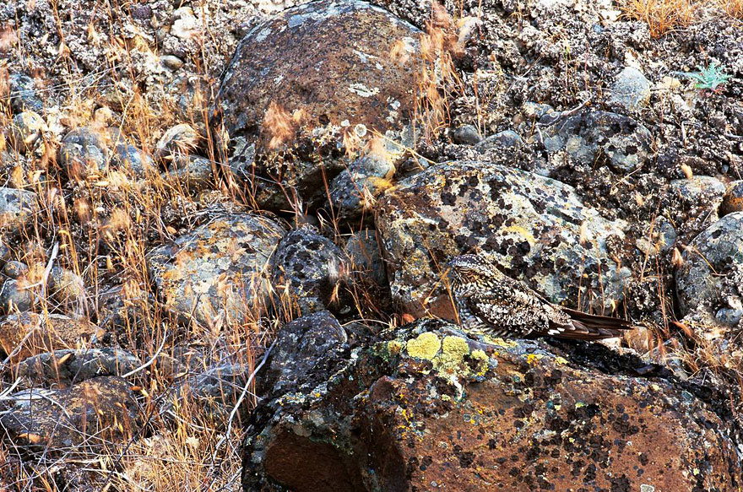

Slide 22
The king of Israel has come out to look for a flea—as one hunts a partridge in the mountains.” 1 Samuel 26:20

Slide 23
The color and/or pattern of an animal often allows it to either blend in or stand out from its environment. This helps them escape predators or hunt more efficiently by being harder to see.
When it blends into its background it is called camouflage.

Slide 24
For we live by faith,
not by sight.
2 Corinthians 5:7

Slide 25
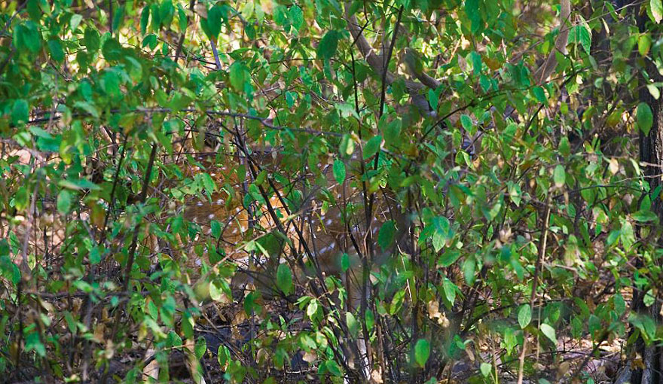

Slide 26
Do you know when the mountain goats give birth? Do you watch when the doe bears her fawn? Job 39:1

Slide 27
For example, many animals that live in snowy areas are white, like the polar bear.
Many animals that live in deserts are sand-colored, many animals that live in trees are green, many animals that live on rocks match the coloration of the rocks and many animals that live near the soil are soil-colored.
Patterns, like stripes or spots, can also help camouflage an animal.

Slide 28
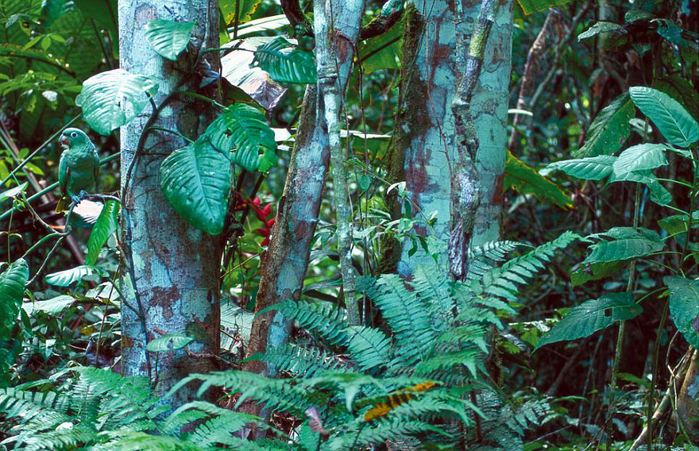

Slide 30
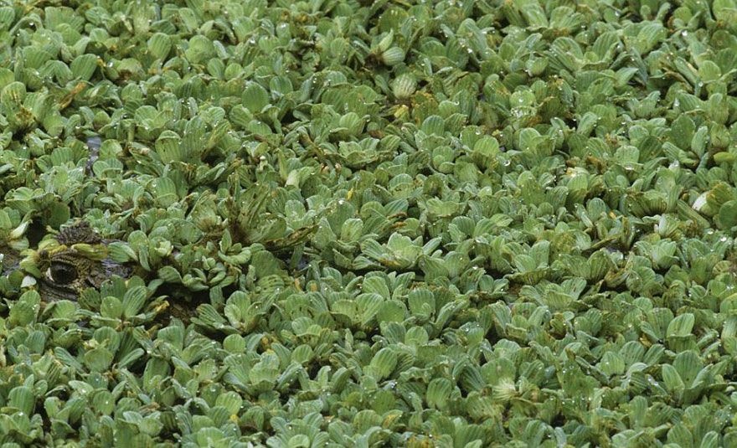

Slide 31
Behemoth - Under the lotus plants it lies, hidden among the reeds in the marsh. The lotuses conceal it in their shadow; Job 40:21-22

Slide 32
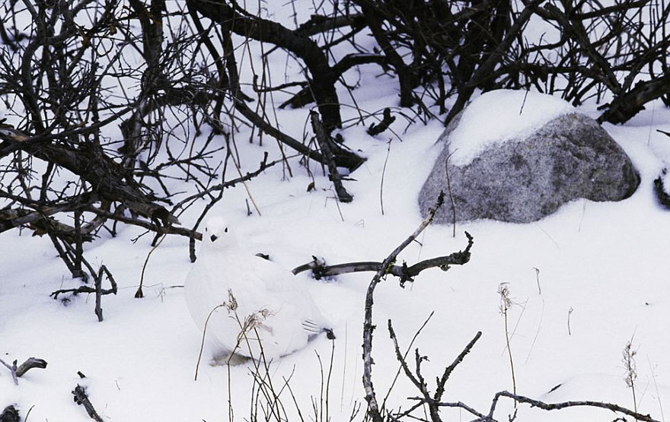

Slide 34
BLENDING is when colors on an animal's body match its surroundings. Examples: crab spider, white-tailed ptarmigan, polar bear, flounder.

Slide 35
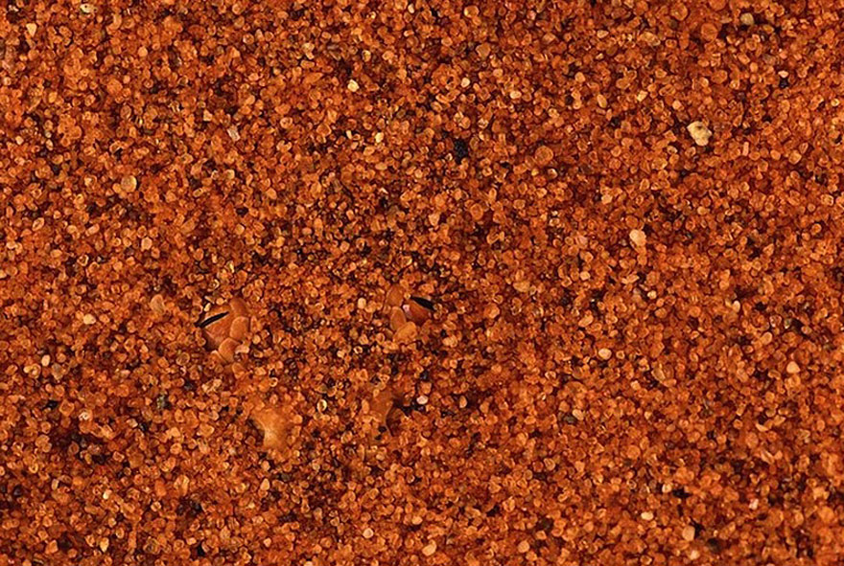

Slide 37
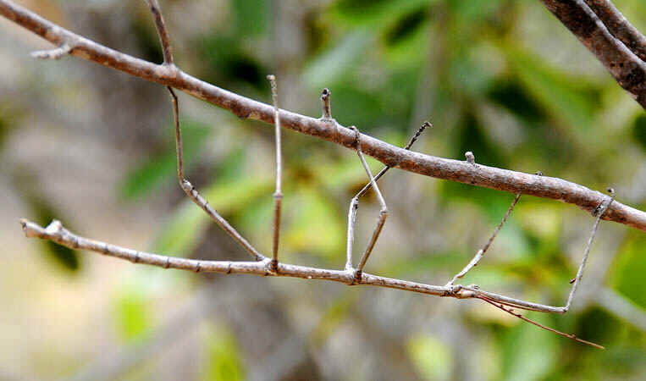

Slide 39
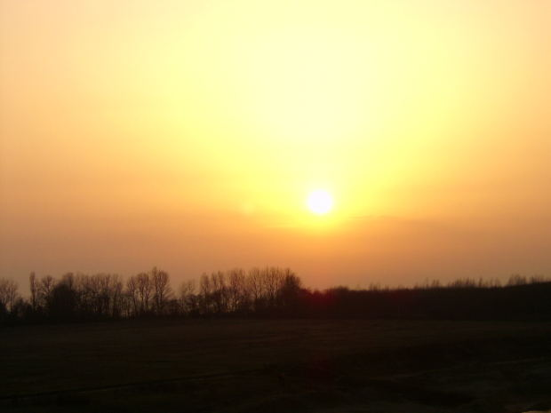
1 John 1:5
Now this is the message we have heard from Him and declare to you:
and there is absolutely no darkness in Him.

Slide 40
Now faith is the reality of what is hoped for, the proof of what is not seen.
Hebrews 11:1

Slide 41
By faith we understand that the universe was created by God’s command, so that what is seen has been made from things that are not visible.
Hebrews 11:3

Slide 42
1 John 1:5
Now this is the message we have heard from Him and declare to you:
and there is absolutely no darkness in Him.

Slide 43
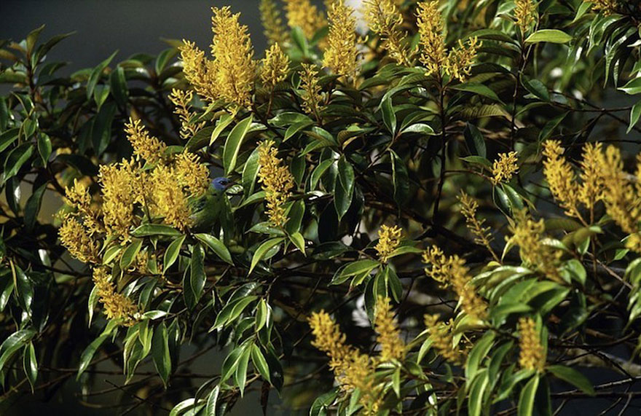

Slide 45
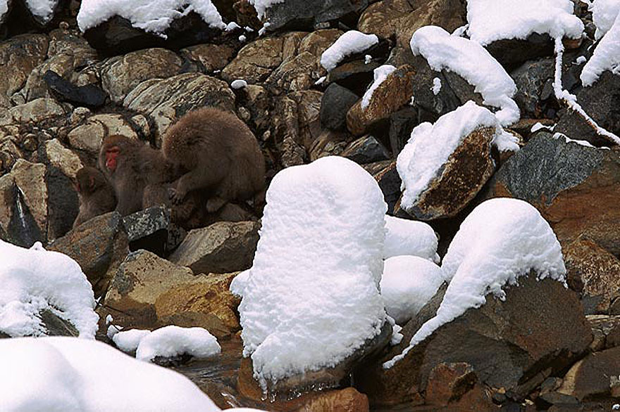

Slide 47
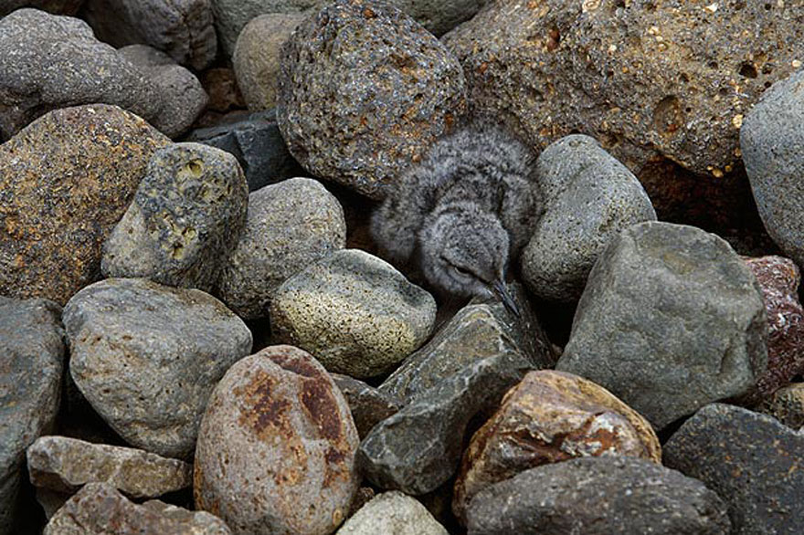

Slide 48
Flee like a bird to your mountain. Psalm 11:1

Slide 49
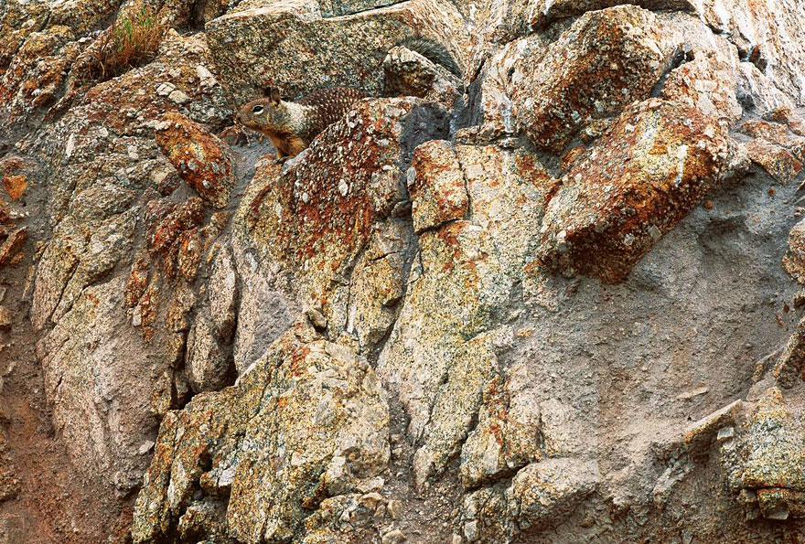

Slide 51
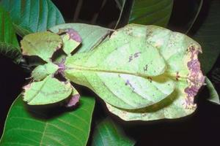

Slide 52
Notes:
Leaf mimic

Slide 53
DISGUISE is when an animal hides in plain sight by looking like an object in its surroundings. Examples: leaf-mimic katydid, walking stick.
Questions:
What is it called when an animal blends into its environment?
What are two reasons why an animal will blend into its environment?

Slide 54
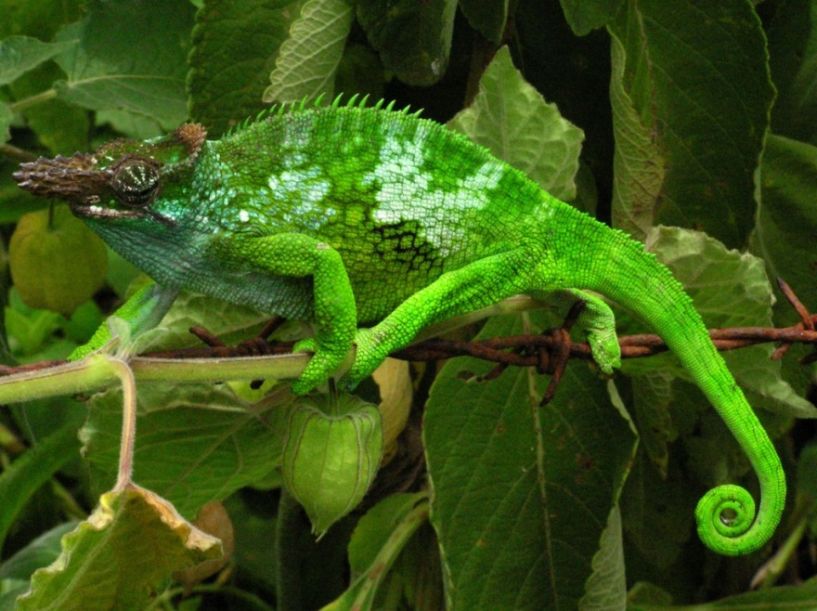
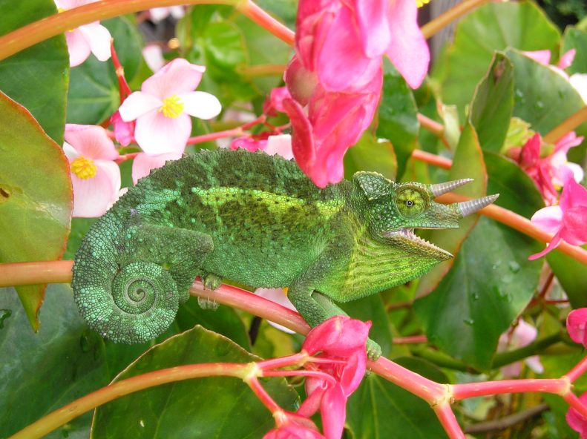
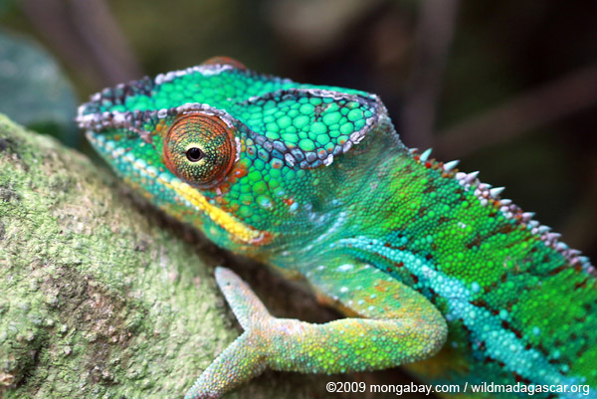
A chameleon can even change its color to blend in with its environment.

Slide 55
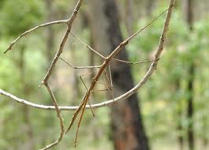

Slide 57
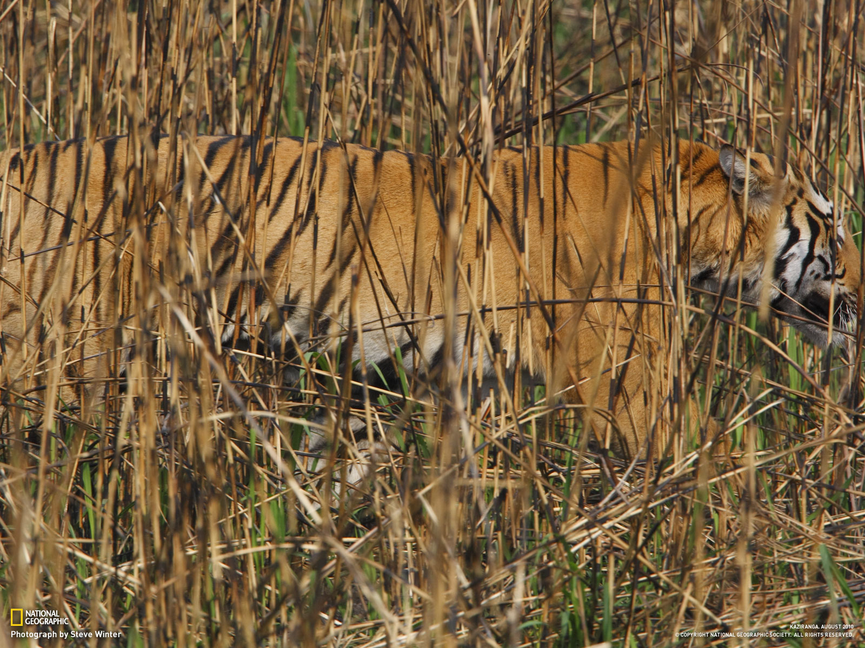

Slide 59
PATTERN is when an animal's stripes, spots, or other color markings make the outline of the animal's body hard to see. Examples: tiger, zebra, leopard frog, blue-ringed octopus.

Slide 60
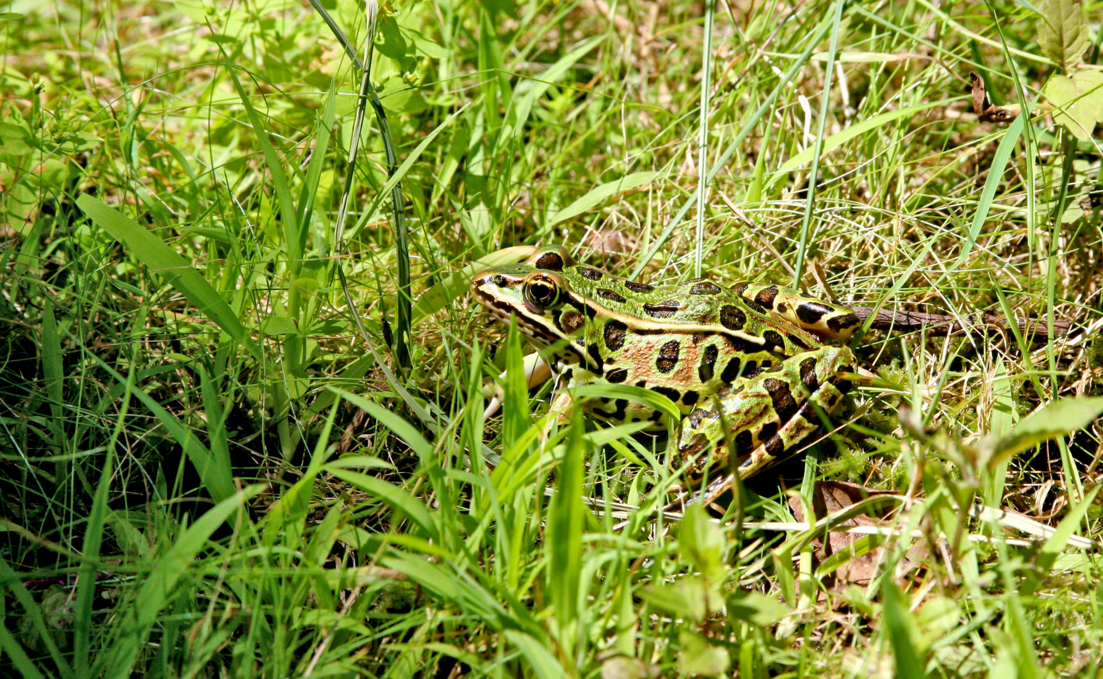

Slide 61
Aaron stretched out his hand over the waters of Egypt, and the frogs came up and covered the land. Exodus 8:6

Slide 62
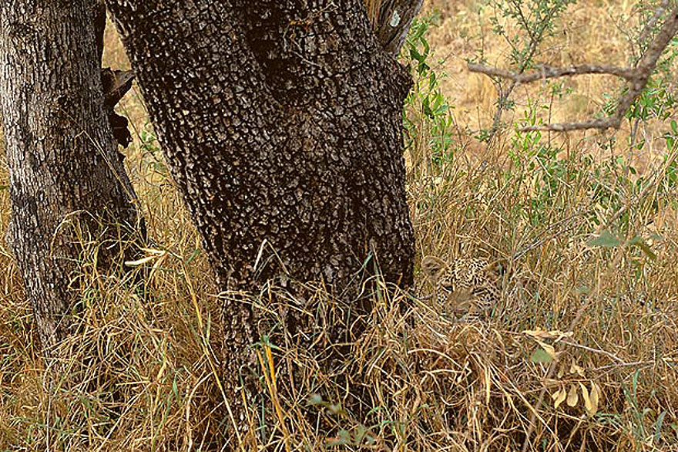
Notes:
http://www.boredpanda.com/animal-camouflage-wolfe/

Slide 63
A leopard will lie in wait near their towns to tear to pieces any who venture out. Jeremiah 5:6

